Slide 1


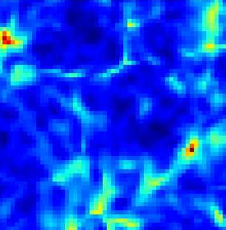
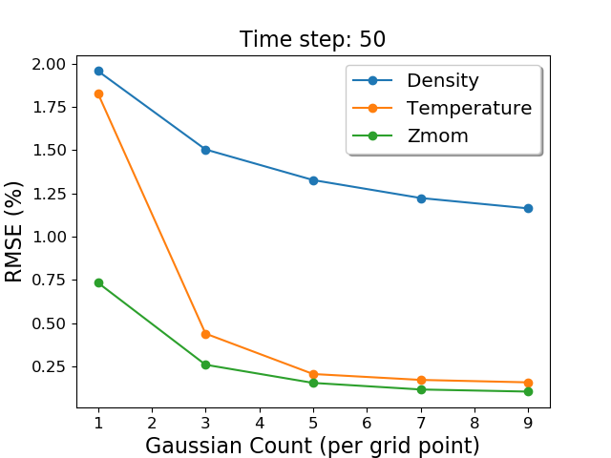
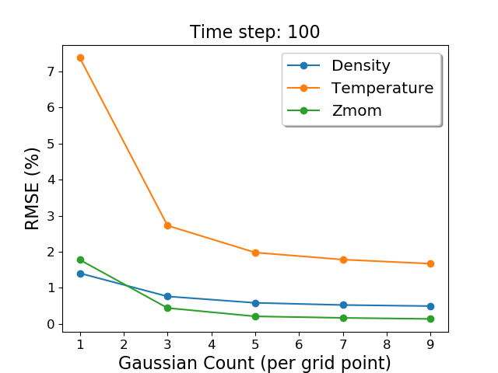
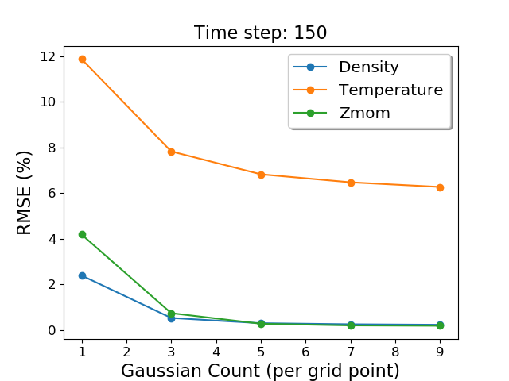
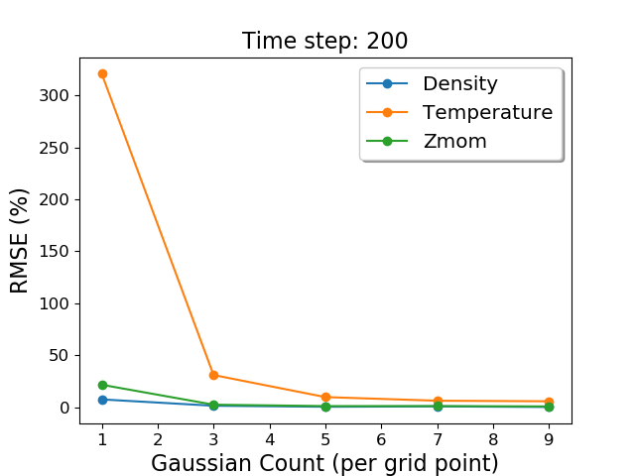
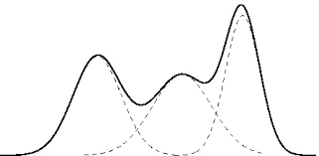
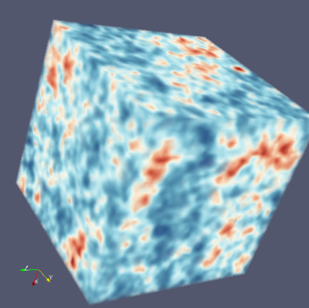

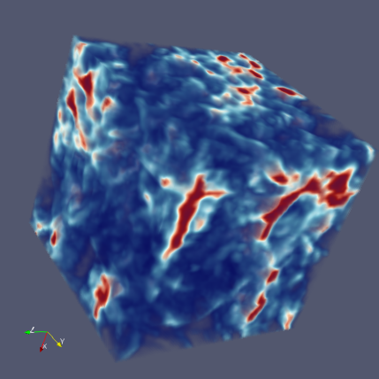

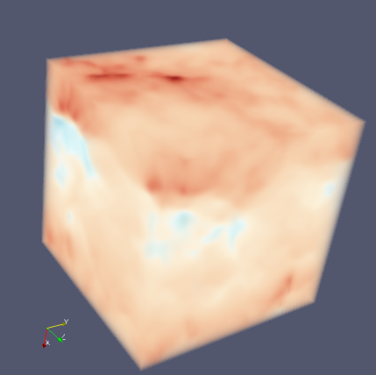

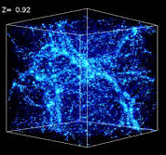
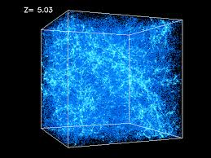
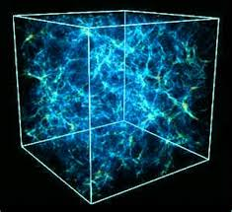
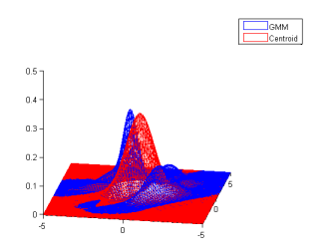
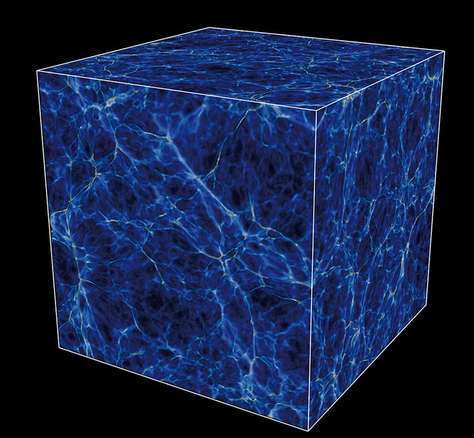
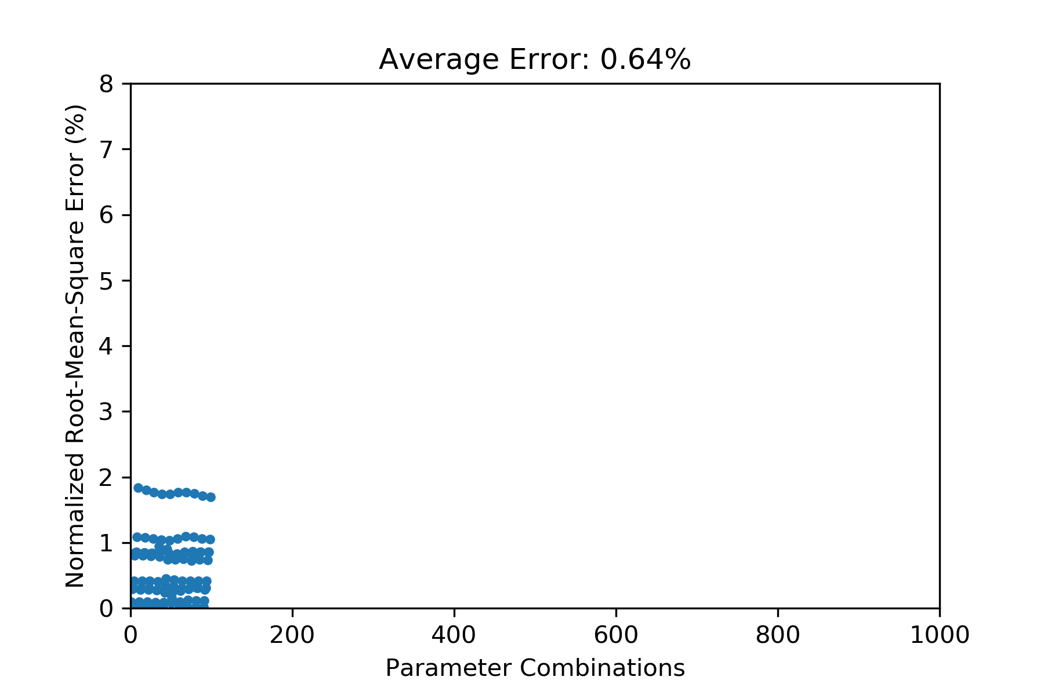
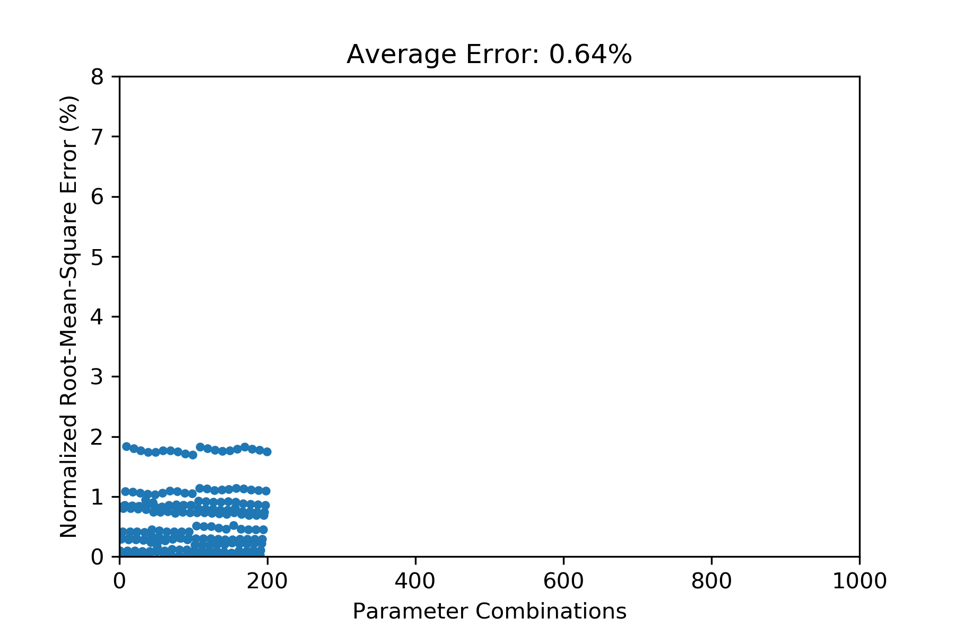
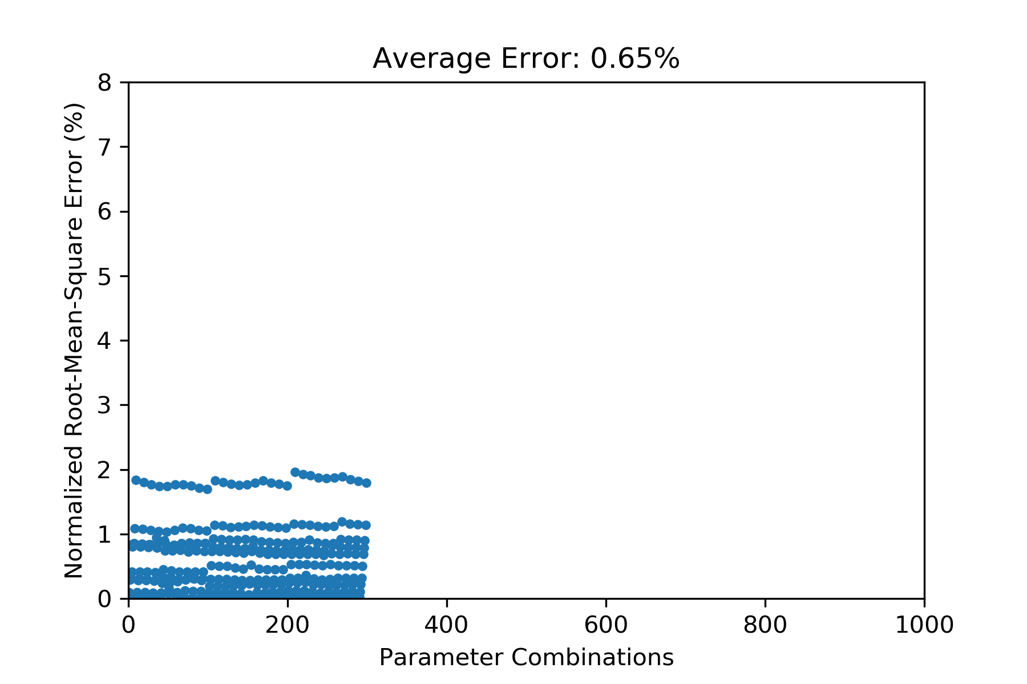
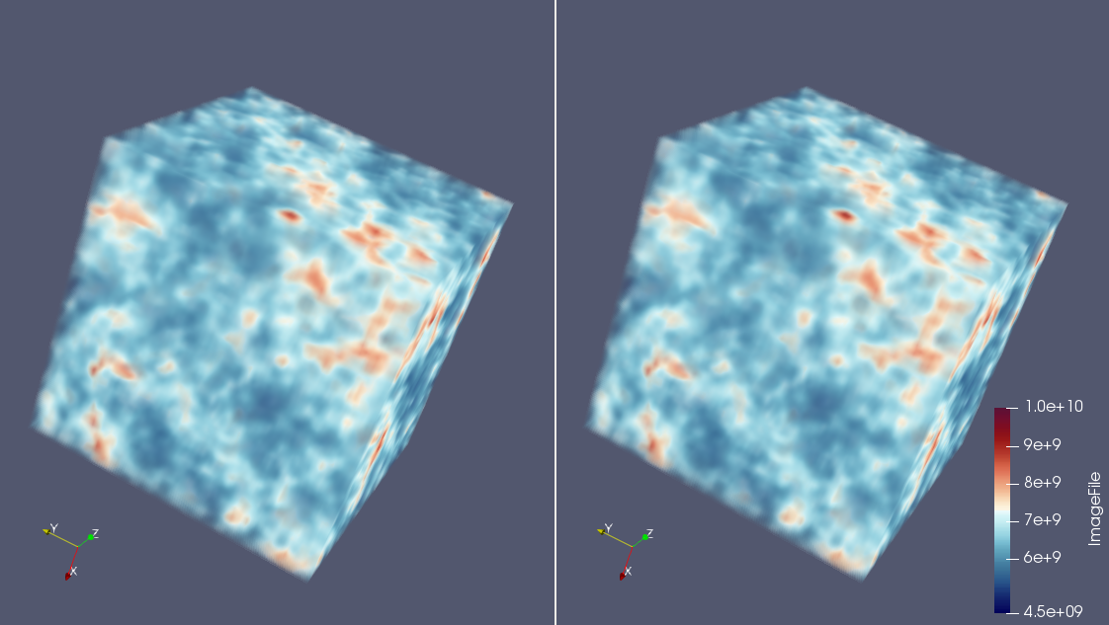
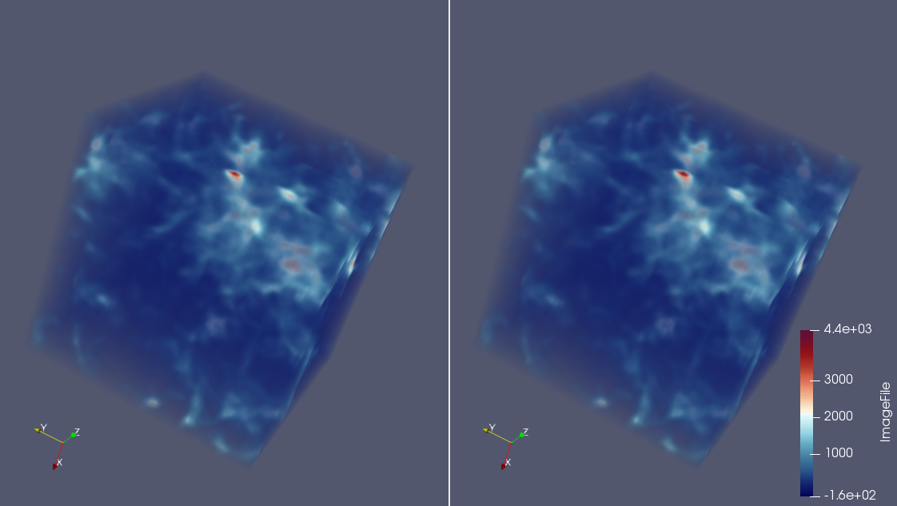
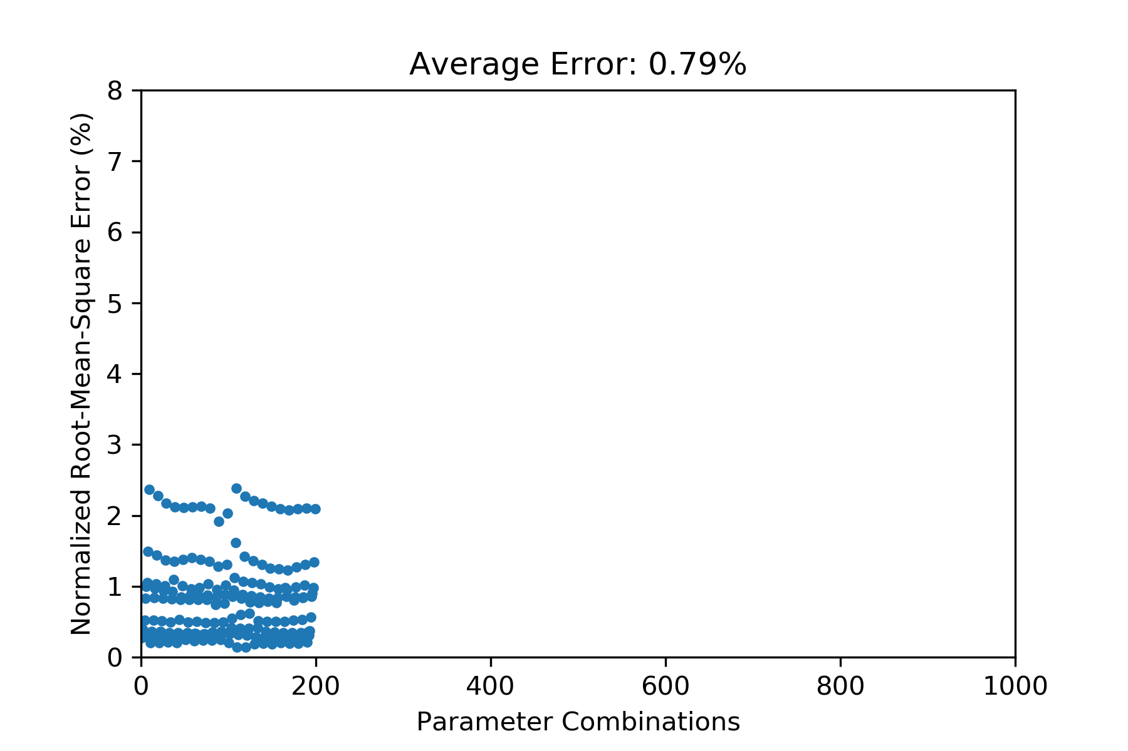
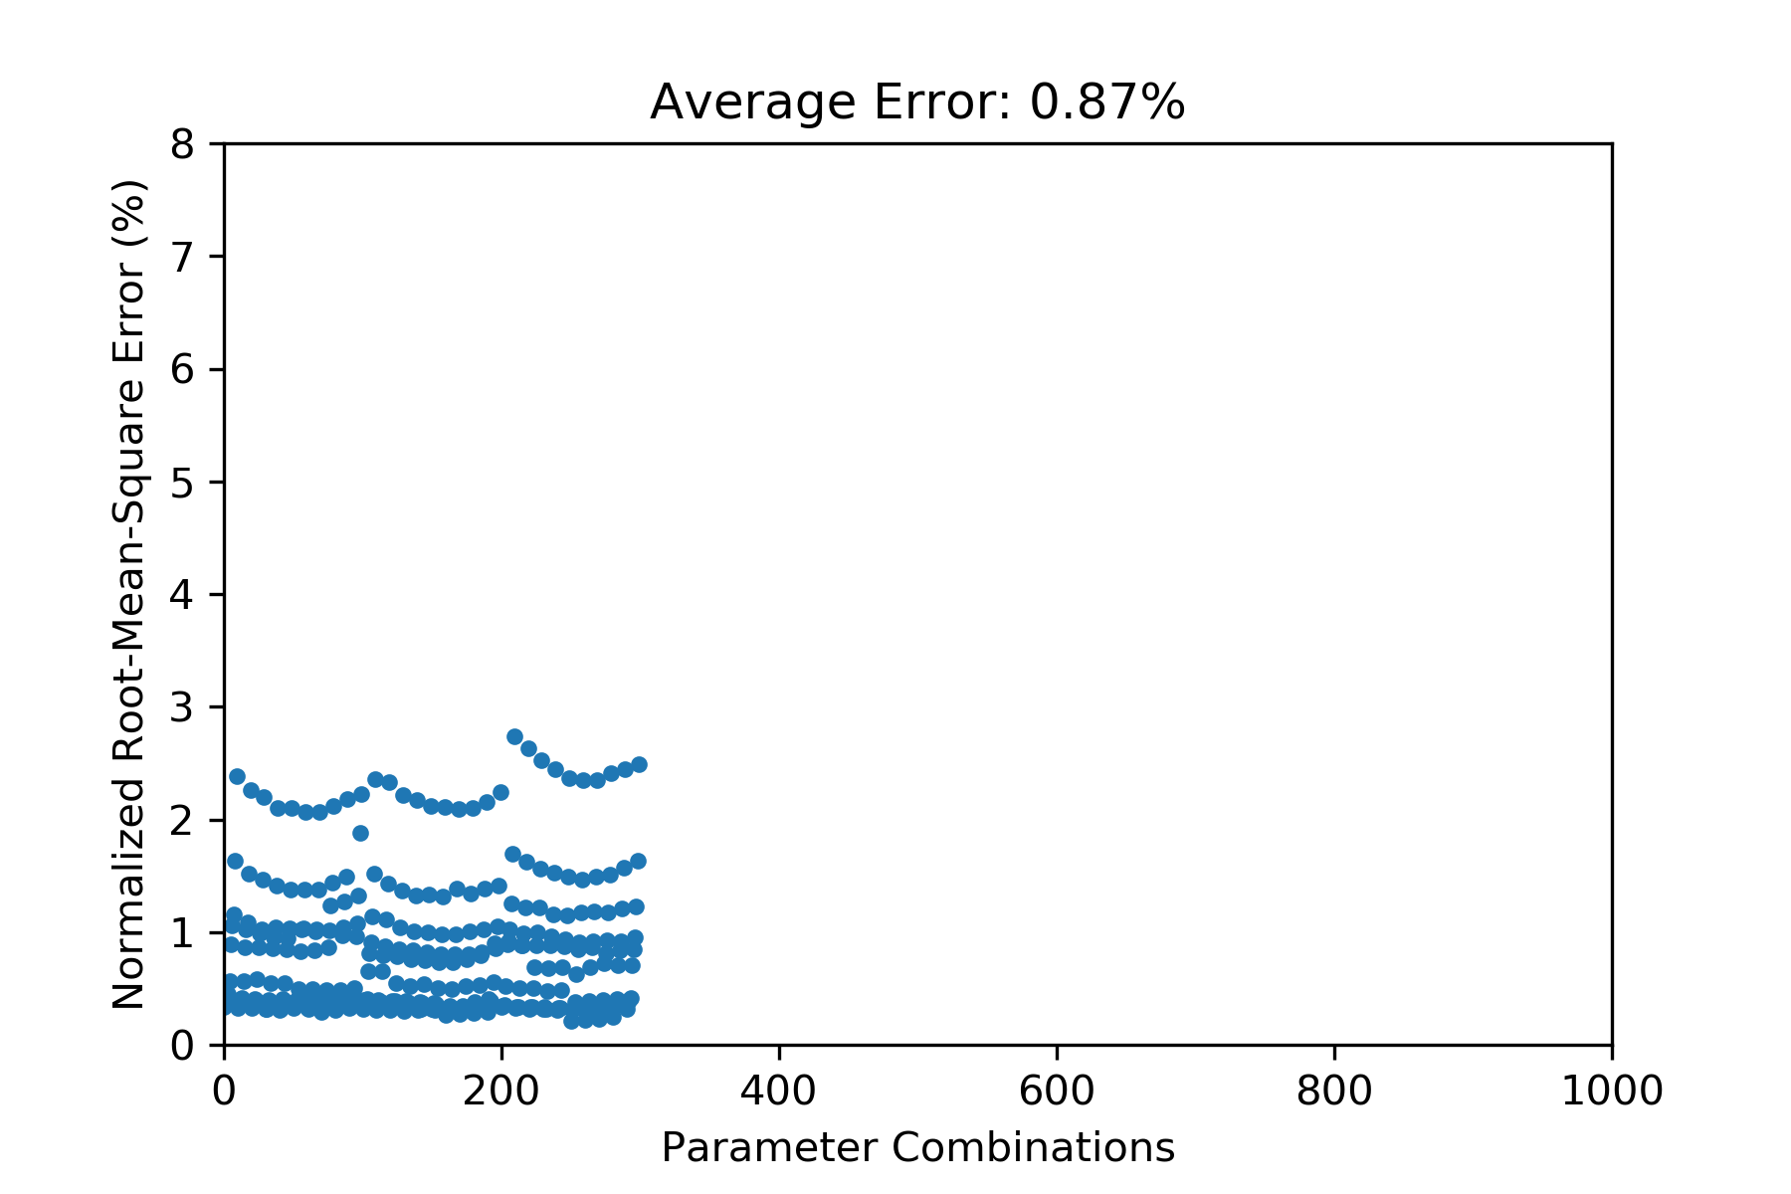
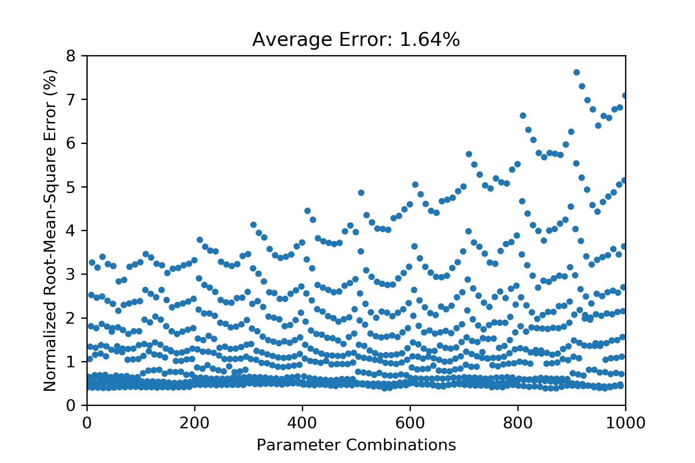
Emulator of Cosmological Simulation for Initial Parameters Study
Abstract
1.1 Reconstruction Results of GMM Emulator
2. Statistical-based Super-resolution
The cosmological model is developed to simulate the evolution of the universe by given initial conditions of the universe. Each initial condition consists of many initial physical parameters. Physicists usually are interested in three to ten of these initial parameters, which create a huge parameter space. Each initial condition of the universe can generate up to ten quantities of interest, and each quantity can have up to 4096^3 grids. Accessing such massive datasets to perform the parameter study on the post-analysis machine could be slow and hinder the analysis task due to the limited I/O bandwidth of the supercomputer. Also, because of the limited storage of disk, dumping all data from simulation and storing on disks are not feasible. Developing techniques to reduce the data size in-situ, and the requirement of the I/O bandwidth and disk storage is critical for the parameter study in the cosmological simulation. We develop two promising techniques, "GMM-based (Gaussian Mixture model) Emulator" and "Statistical-base Super-resolution", to achieve our goal. GMM-based Emulator uses multi-variate GMM to compactly summarize the data from initial simulation parameters and quantities of interest. The GMM-based emulator can be built incrementally when the data of new initial parameters comes. Statistical-based Super-resolution statistically down-samples the data in-situ and recovers the down-sampled data to full resolution when scientists analyze the data in the post-processing stage. A one-time task which collects full-resolution data generated from a small set of initial conditions creates the prior knowledge for super-resolution. The statistical-based down-sampling reduces the size of data from other initial conditions by using distribution to summarize data values in each local block. The prior knowledge is used to compensate for the lack of spatial information of the statistical-based down-sampled data and recover it to full-resolution.
Reconstruction errors become low and stable when we use 5 or more Gaussians for each grid point.
Super-resolution technique in computer vision community uses information from small set of training images to recover other down-sampled images to raw resolution
Challenge: data range of different initial simulation parameters could be very different
Observation: locations of relatively higher and lower values in a local region are often similar across the data from different initial simulation parameters
Compactly summarizing data in each down-sampled blocks by distributions can preserve absolute data values in the block
Prior knowledge/dictionary created from the data generated from a few initial simulation parameters compensates the lack of spatial information to recover down-sampled distribution blocks to raw resolution blocks
Statistical
Down-sampling
Reconstruction Showcase
Density Timestep: 50
Temperature Timestep: 100
z-momentum Timestep: 150
2.1 System Workflow
Create prior knowledge
from a few parameters
Simulate & output full resolution data
Dictionary /
Prior knowledge
Disk
Low Res. Feature | High Res. Block
… | …
… | …
Raw
Reconstruction
Raw
Reconstruction
Raw
Reconstruction
Size Reduction
Gaussian Counts | 1 | 3 | 5 | 7 | 9
Size | 1.5% | 4.5% | 7.5% | 10.5% | 13.5%
Size Reduction | 98.5% | 95.5% | 92.5% | 89.5% | 86.5%
In-situ statistical down-sampling
High Resolution Data
simulation run
w/ new parameter
..…
Objectives
1.2 Incremental Training of GMM
Initial Simulation Parameters
Reduce cosmological data size in-situ to satisfy the requirement of the I/O bandwidth and disk storage.
Reconstruct cosmological data with low error using our emulator.
Enhance emulators for in-situ analysis.
When doing in-situ data analysis, we train GMM incrementally when the data of new initial parameters come; also, when the data is too large to be held in the memory, we also need to train GMM progressively.
The incremental training method we use can keep around 0.64% reconstruction error for density quantity.
2.2 Experiment Results
Test on 3 parameters and 3 quantities of interest and 64³ resolution data
5 initial simulation parameters are used to generate full-resolution data and generate the prior knowledge
The data generated by other initial parameters are in-situ reduced to 2.92% (of full resolution data) statistical-based down-sampled data
Reconstructions on different quantities, time steps and initial parameters have slightly different error. Average error of density, temperature and z-mom are 0.6, 2.1 and 0.42%, respectively
1. GMM Emulator
6 Gaussians
12 Gaussians
18 Gaussians
GMM-based Emulator uses multi-variate GMM to compactly summarize the data from initial simulation parameters in the joint space of parameters and the quantity of interest.
The data of a precise initial condition can be reconstructed from the emulator in the post-analysis stage.
Also, the storage size of the GMM emulator is much less than the size of simulation data.
The GMM-based emulator can be built incrementally when the data of new initial parameters comes.
Considering the memory constraint for the size of GMM emulator, we apply re-sampling and re-training process to reduce the size of trained GMM emulator.
Prediction: The GMM emulator can learn data of sampled initial conditions to predict data of untrained initial conditions with low error.
1.3 Incremental Training with Memory Constraint for Model Size
The GMM size increases linearly when training incrementally. Memory may not be able to hold the entire model some time.
We apply a re-sampling and re-training process to reduce the size of the GMM emulator.
Reconstruction errors become larger but acceptable.
5 Gaussians
5 Gaussians
5 Gaussians
Density: Raw
Our reconstruction
RMSE: 0.706%
Temperature: Raw
Our reconstruction
RMSE: 0.597%

